Slide 1
Biodiversity Analysis
National Park Services

Slide 2
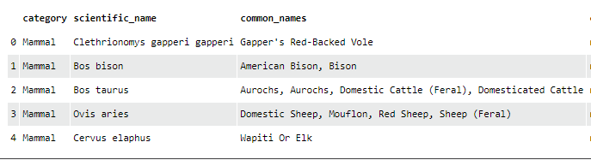

Scientific data from the National Park

Slide 3
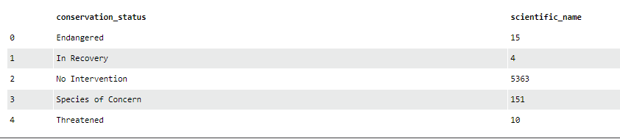
Categories of the conservation status

Slide 4
Types of Species
['Mammal' 'Bird' 'Reptile' 'Amphibian' 'Fish' 'Vascular Plant' 'Nonvascular Plant']
['Mammal' 'Bird' 'Reptile' 'Amphibian' 'Fish' 'Vascular Plant' 'Nonvascular Plant']
['Mammal' 'Bird' 'Reptile' 'Amphibian' 'Fish' 'Vascular Plant' 'Nonvascular Plant']
Mammal
Bird
Reptile
Amphibian
Fish
Vascular Plant
Nonvascular Plant
['Mammal' 'Bird' 'Reptile' 'Amphibian' 'Fish' 'Vascular Plant' 'Nonvascular Plant']

Slide 5

Data on conservation status
conservation_status scientific_name 0 Endangered 15 1 In Recovery 4 2 No Intervention 5363 3 Species of Concern 151 4 Threatened 10
conservation_status scientific_name 0 Endangered 15 1 In Recovery 4 2 No Intervention 5363 3 Species of Concern 151 4 Threatened 10

Slide 6
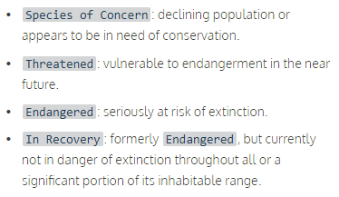
The nature of each conservation status

Slide 7
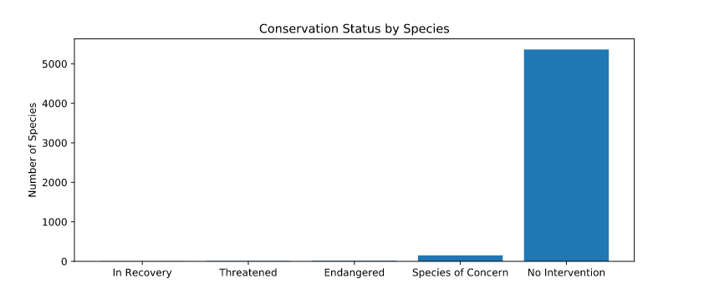
Conservation Status by Species

Slide 8
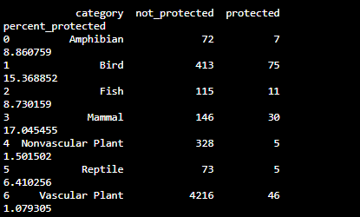
Investigating endangered species

Slide 9
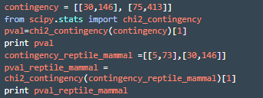

Determining if certain types of species are more likely to be endangered?
Chi-Squared Test for Significance
Calculations
P values

Slide 10
Results of Chi-Squared Test for Significance
After calculating a difference in the percentages of mammals and birds, test let me determine that the difference was a result of chance. P value of 0.68 was greater than 0.05
However, when I compared the percentages of mammals and reptiles I found out that the difference was significant since p value of 0.03 was less than 0.05
Running the test with two different outputs brought me to conclusion that certain types of species are more likely to be endangered than others.

Slide 11
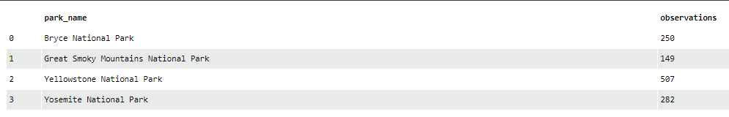
Observations of species by the category Park

Slide 12
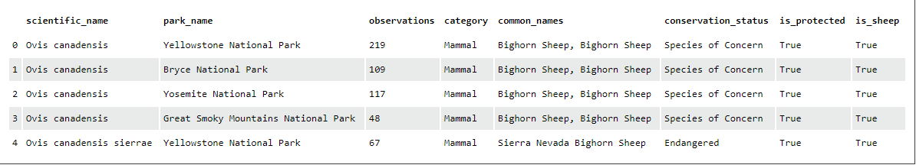
Analysis of the species Sheep by the Park

Slide 13
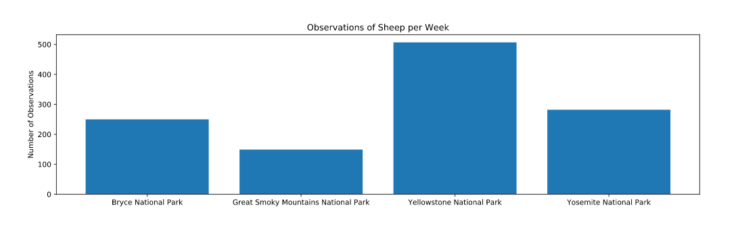
Illustration of the sightings at each of the four national parks

Slide 14
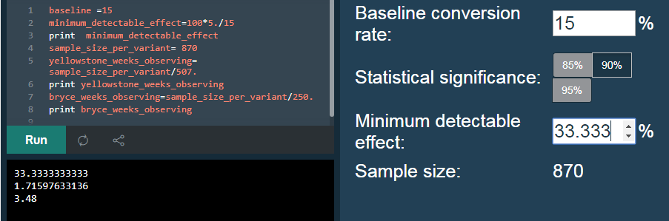
Analysis of the foot and mouth disease at Yellowstone and Bryce park
Considering baseline of 15% occurrence of foot and mouth disease in sheep at Bryce National Park. In case of Yellowstone Park scientists would have to observe for more than one week and in case of Bryce park it would take over 3 weeks.

